Slide 1

Fleet Rental Management System
Group 15:
Adarsh Prakash
Appanna PM
Atharv Keshre
Sharath Chandra
Vaishnavi Bhoite

Slide 2
Project Overview The Fleet Leasing Management Database System is designed to streamline and enhance the efficiency of vehicle management and rental processes for individuals and businesses through a comprehensive app that supports reservations, transactions, and customer management. Establish a database to manage details about available cars, their specifications, and rental history effectively.
Ensure a smooth and user-friendly experience for customers and administrators throughout the vehicle rental process.
Implementing stored procedures, functions, triggers, and views to enhance database efficiency, integrity, and security.
Utilization of encryption to safeguard sensitive data.
Integrating with Power BI to provide comprehensive data visualization and reporting capabilities, enabling better strategic decision-making.
Developed a graphical user interface (GUI) that is intuitive and accessible, enhancing user interaction and functionality of the system.

Slide 3
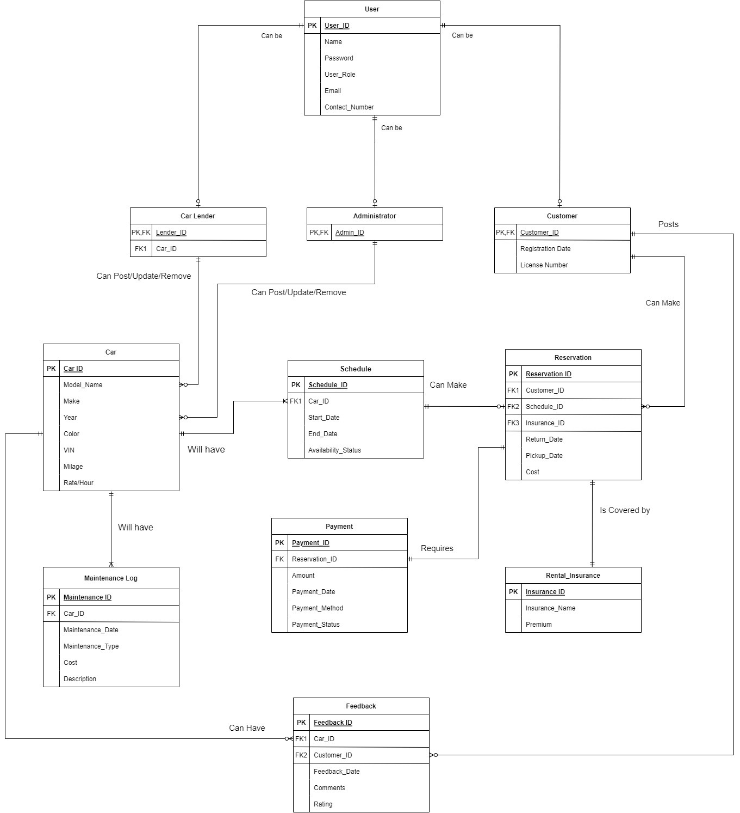
Entity Relationship Diagram(ERD):

Slide 4
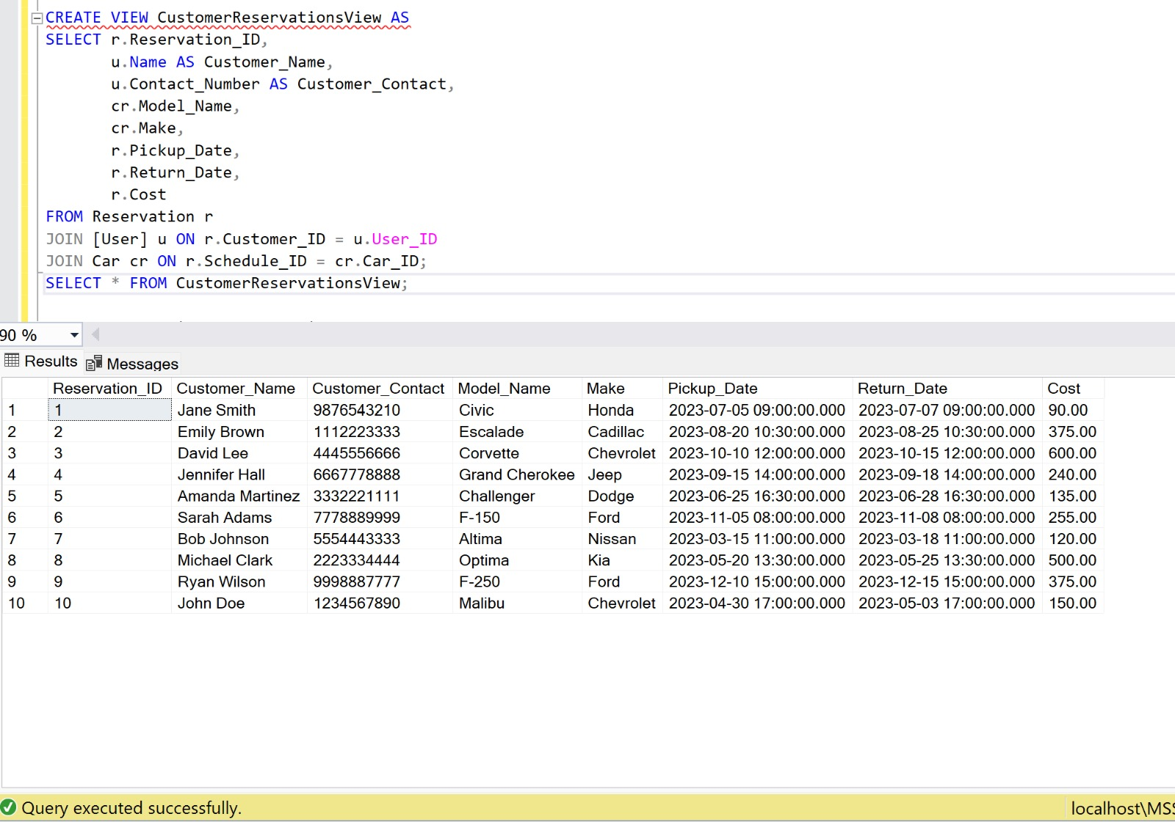
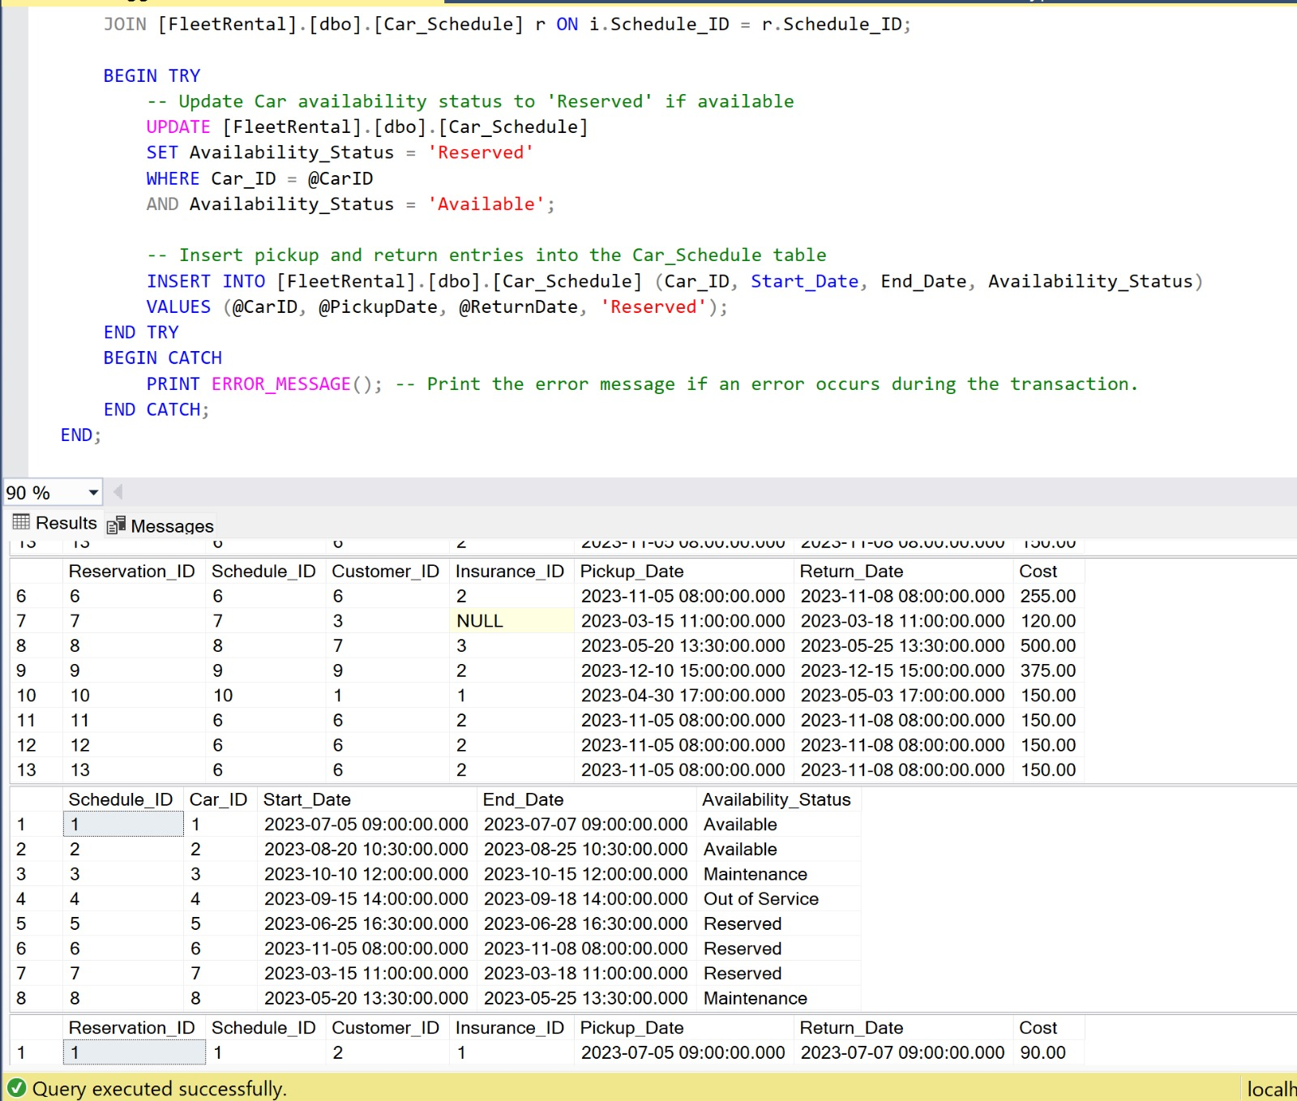
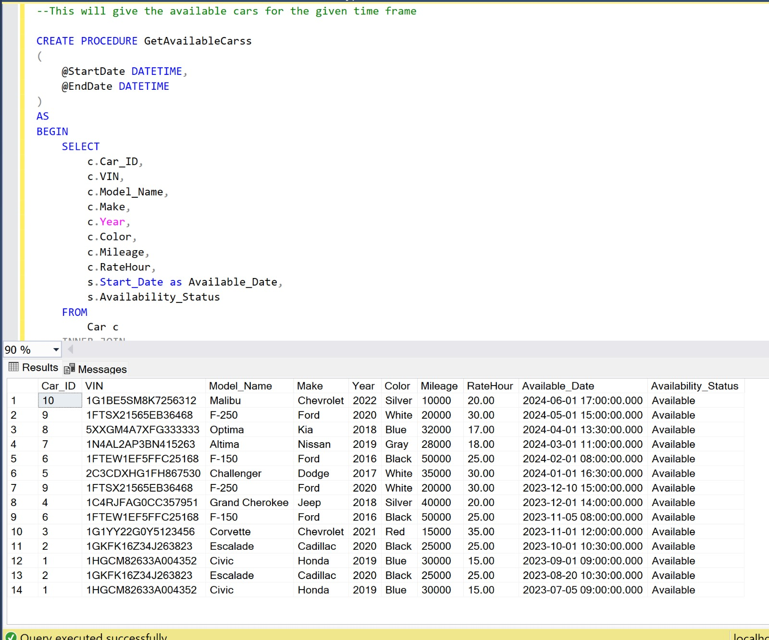
VIEWS / PROCEDURES / TRIGGERS:

Slide 5
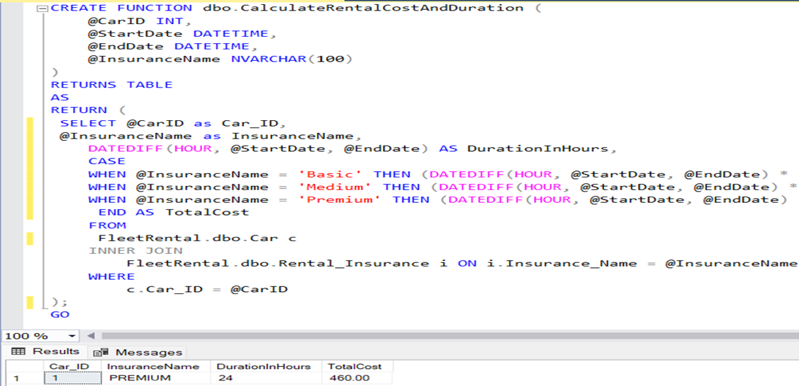
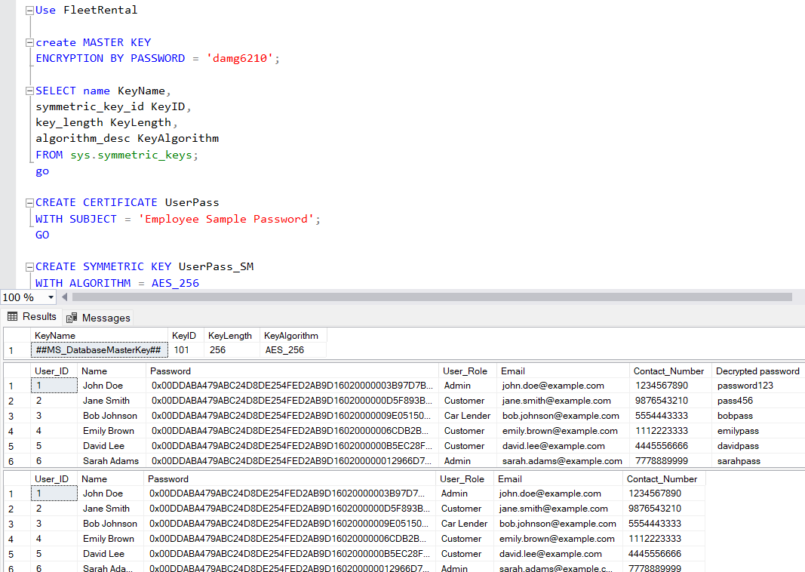
FUNCTIONS AND ENCRYPTION:

Slide 6
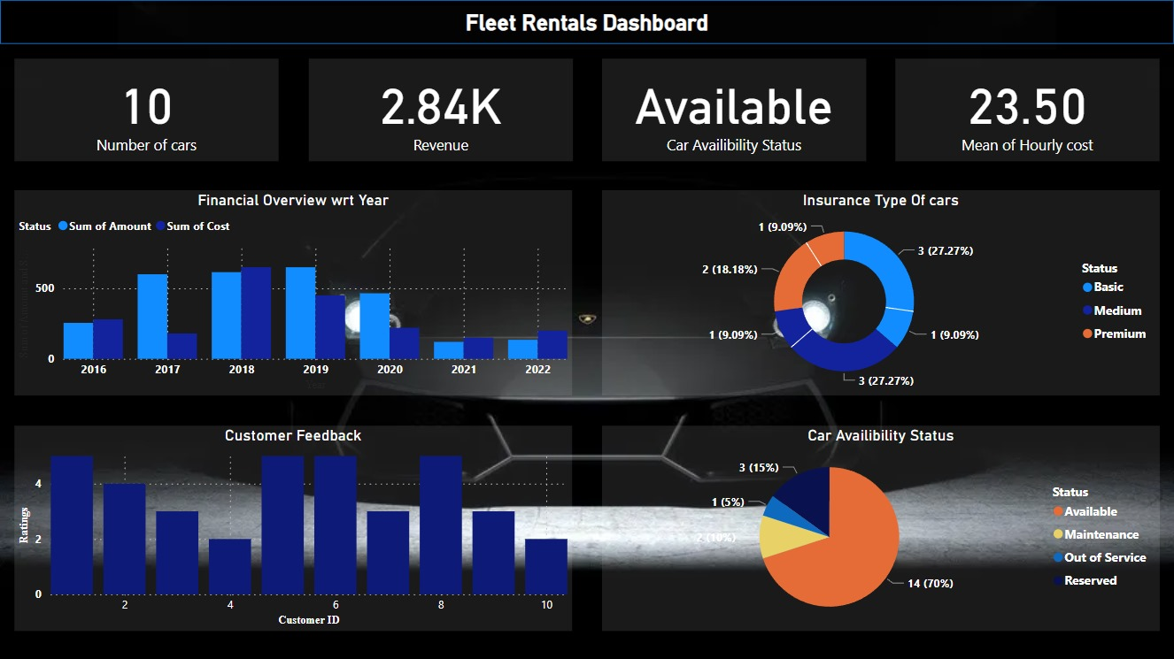
Power BI Dashboard

Slide 7
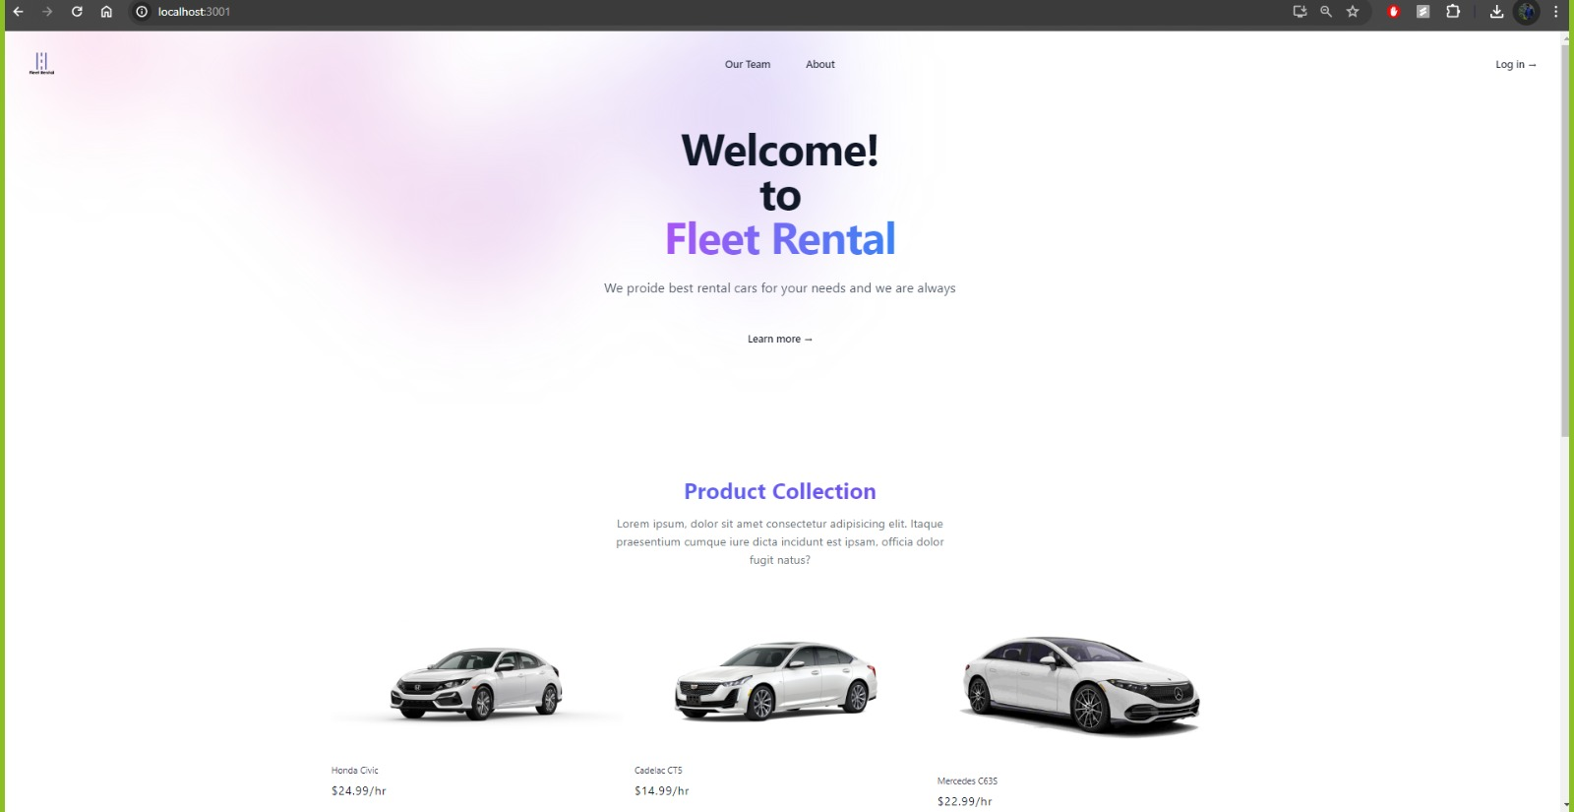
Graphical User Interface (GUI)

Slide 8

Demo:

